Slide 1
ESMValTool Tutorial: Moving away from Software Carpentry
Emma Hogan
ESMValTool Workshop
Wednesday, November 19, 2025
11:00 - 11:30 CET

Slide 2
Overview
🛠️ESMValTool Tutorial: current tooling [5 mins]
❗The problem [5 mins]
💡Potential solution [5 mins]
🔍Feature analysis of potential solution [5 mins]
❓Questions [10 minutes]

Slide 3
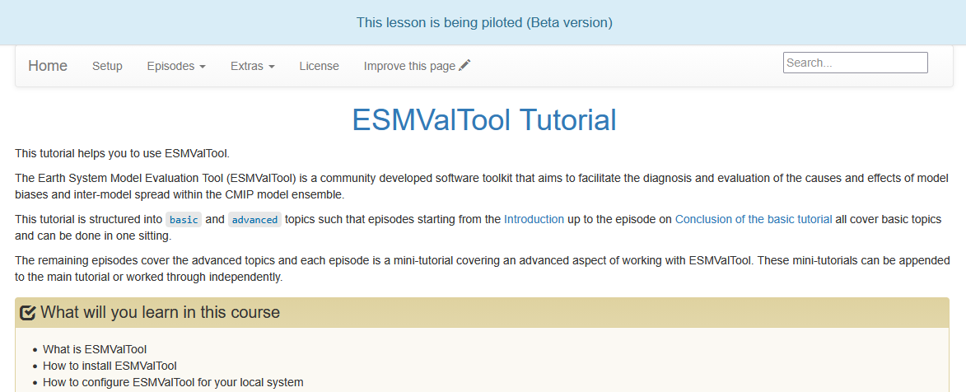
🛠️ESMValTool Tutorial: current tooling
The Carpentries: carpentries/styles lesson infrastructure
Notes:
+ The ESMValTool Tutorial currently uses a lesson infrastructure, or template, called the “carpentries/styles”.

Slide 4
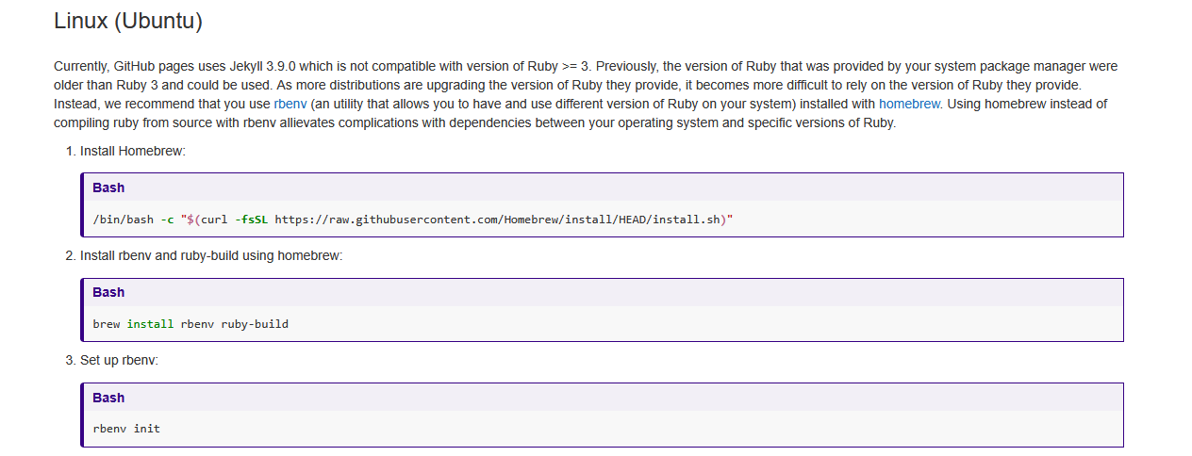
🛠️ESMValTool Tutorial: current tooling
https://carpentries.github.io/lesson-example/setup.html#linux-ubuntu
Notes:
+ This carpentries template requires a Ruby-based installation.
+ I remember when I created the environment for the ESMValTool Tutorial back in 2021 it was not straight-forward for me, and I haven’t been able to create a new environment since!
+ When Chris tried to create an environment for the ESMValTool Tutorial last year Conda failed to create an environment.

Slide 5
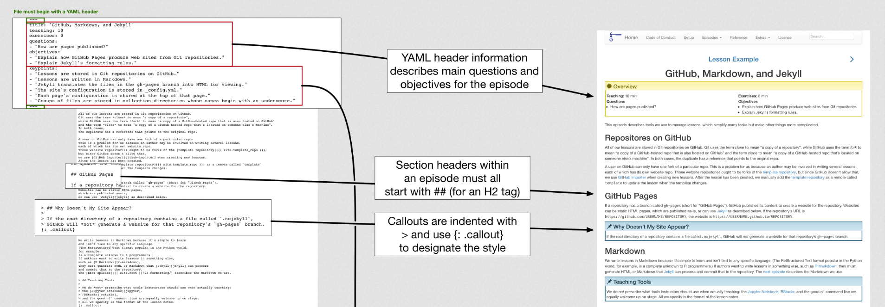
🛠️ESMValTool Tutorial: current tooling
https://carpentries.github.io/lesson-example/04-formatting/index.html
Notes:
+ Lessons are written in Markdown, but with specific format requirements and additional syntax to enable features.

Slide 6
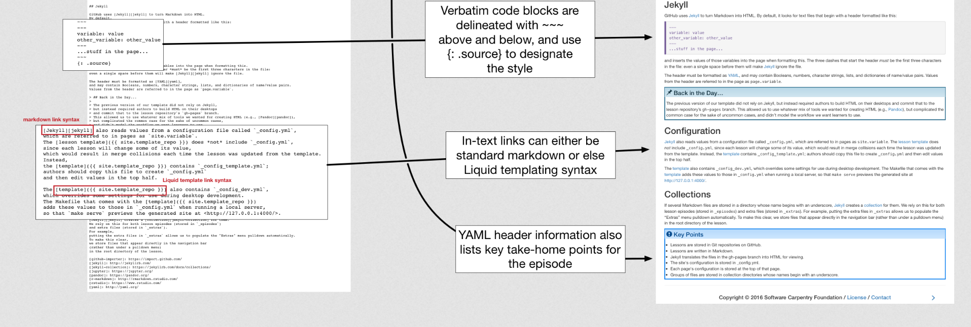
🛠️ESMValTool Tutorial: current tooling
https://carpentries.github.io/lesson-example/04-formatting/index.html

Slide 7
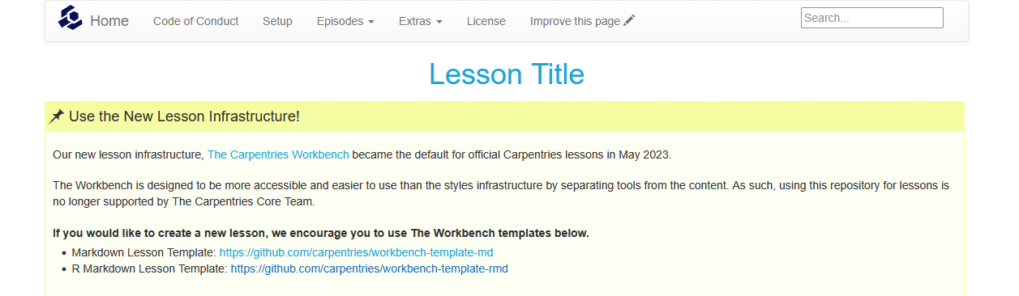
❗The problem
https://carpentries.github.io/lesson-example/
Notes:
+ The problem is that the “carpentries/styles” template is no longer supported by The Carpentries Core Team.
+ A new lesson infrastructure called “The Carpentries Workbench” became the default template for official Carpentries lessons in May 2023.

Slide 8
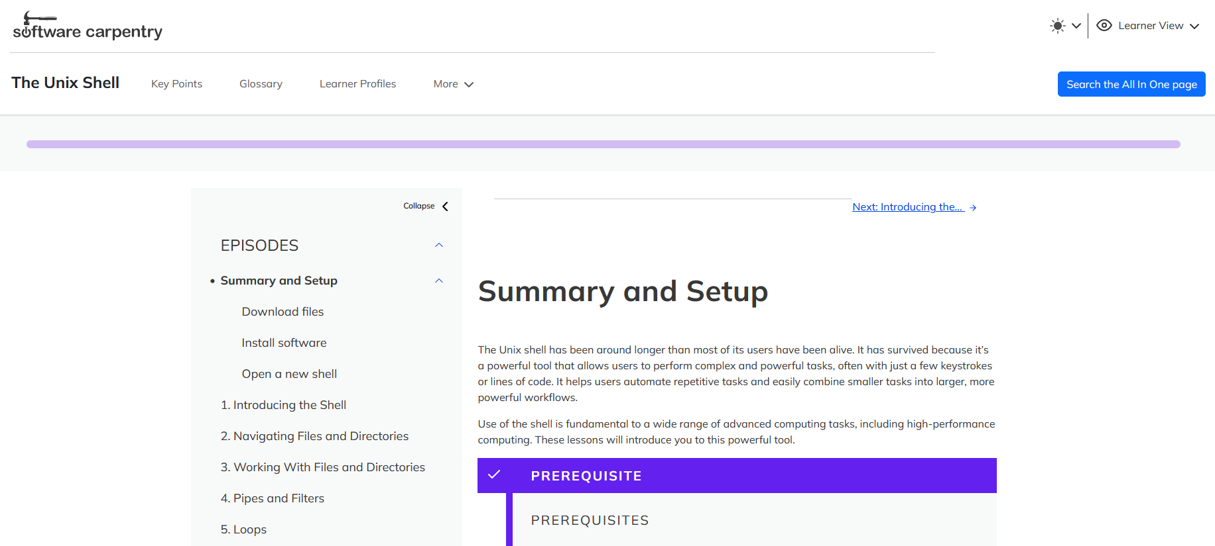
https://swcarpentry.github.io/shell-novice/
Notes:
+ Here is an example of what “The Carpentries Workbench” template looks like.
+ “The Carpentries Workbench” is built using R.

Slide 9
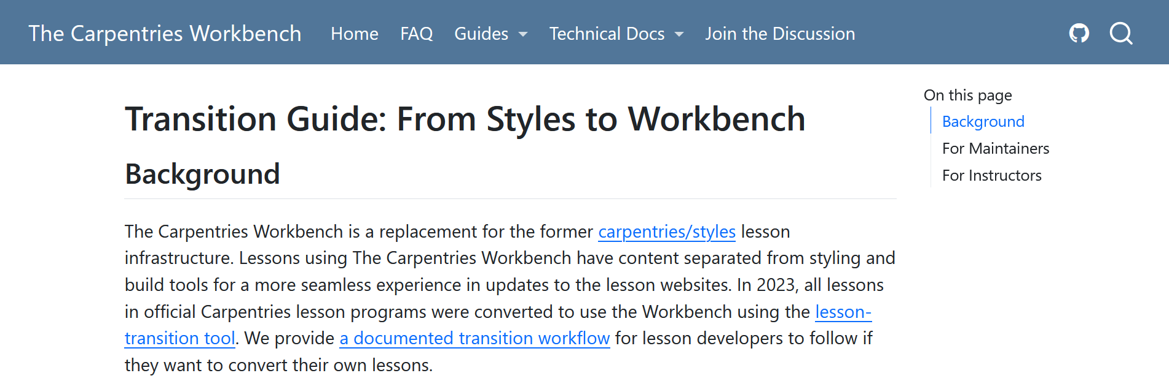
❗The problem
https://carpentries.github.io/workbench/transition-guide.html
Notes:
+ “The Carpentries Workbench” has provided a Transition Guide, and ...

Slide 10
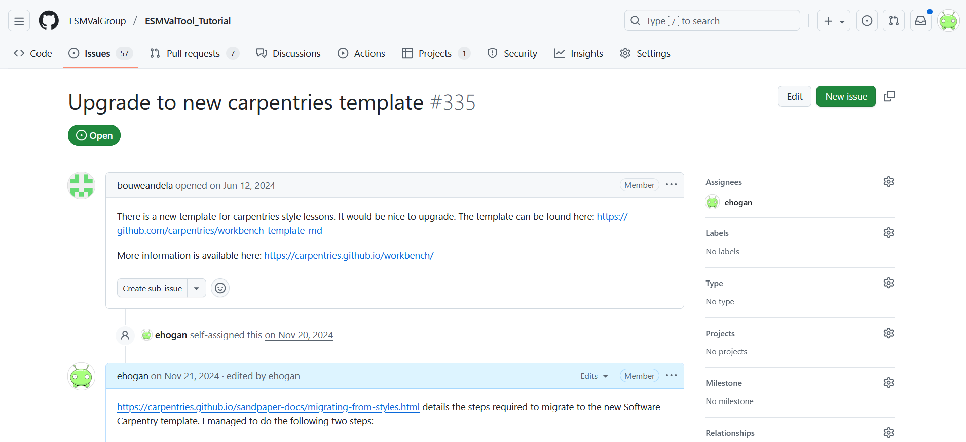
https://github.com/ESMValGroup/ESMValTool_Tutorial/issues/335
Notes:
+ ... during the virtual ESMValTool community workshop this time last year, I attempted to follow this Transition Guide to upgrade the ESMValTool Tutorial to use this new template.

Slide 11


Slide 12
❗The problem: a summary
➡️ We need to move away from the old “carpentries/styles” lesson infrastructure:
  ✖️It is no longer supported by The Carpentries Core Team
  💎The Ruby-based installation is difficult to create, update and maintain
  📝 Lessons are written in Markdown, but with specific format requirements and additional syntax to enable features
🔀However, the Transition Guide for the “The Carpentries Workbench” did not work for me
Notes:
+ Given these problems, I am struggling to see the benefits of continuing to use the Software Carpentry template.

Slide 13
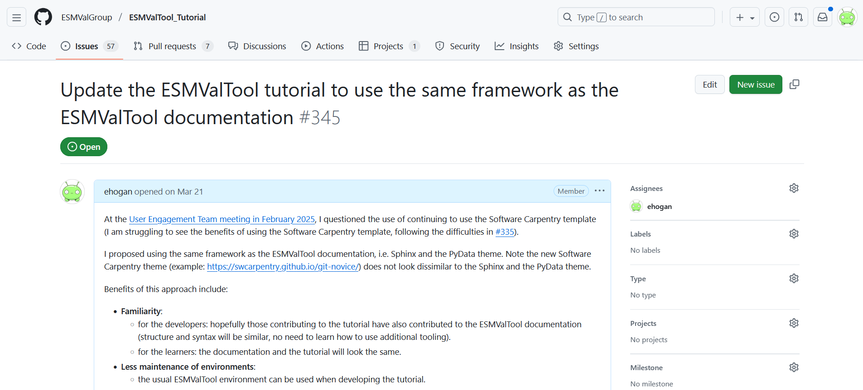
https://github.com/ESMValGroup/ESMValTool_Tutorial/issues/345
Notes:
+ So, at the UET meeting in February, I proposed that the ESMValTool Tutorial use the same framework as the ESMValTool documentation, i.e. Sphinx and the PyData theme.

Slide 14
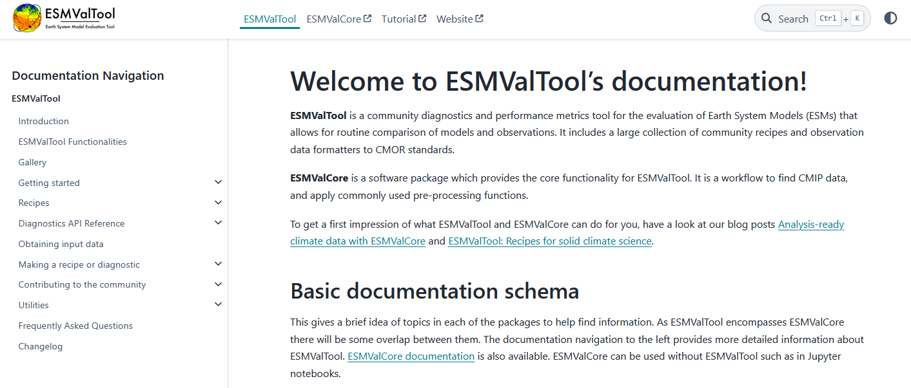
Logo
Section links
Dark / light mode
Search
Primary Sidebar
Notes:
+ Note the new Software Carpentry theme does not look dissimilar to the Sphinx and the PyData theme.

Slide 15
💡Potential solution: the benefits
🟰Familiarity:
  📝for the developers: structure and syntax would be the same
  👤for the learners: theme and layout would be the same
🛠️Less maintenance of tutorials:
  🌍for all: architecture: fits into the Diátaxis structure perfectly
  📝for the developers: content: update at the same time as the code
🛠️Less maintenance of environments:
  📝for the developers: use the usual ESMValTool environment
Notes:
+ The structure and syntax would be the same for both the tutorial and the documentation.
+ There will be no need to learn how to use additional tooling, so making changes should be easier.
+ The theme and layout would be the same for both the tutorial and the documentation.
+ There would be no need to maintain separate, difficult-to-build R-based environments.

Slide 16
💡Potential solution: the benefits
☁️Hosting improvements:
  🌍for all: part of the documentation via Read the Docs (RTD)
  📝for the developers: changes would be reviewable via PRs
♾️More contributions:
  🌍for all: new tutorials could be easily contributed
The current ESMValTool Tutorial could be split:
  either into two (basic and advanced)
  or into many “bite-sized” tutorials that can be uniquely combined depending on the needs of the learners
Notes:
+ Enabling adding other tutorials, e.g. from ACCESS-NRI & MO, domain-specific, etc.

Slide 17
🔍Feature analysis of potential solution
Sphinx and the PyData theme offers:
  The use of both reStructuredText (reST) and Markdown
  Code blocks with syntax highlighting
  Admonitions
  In addition, the theme can be extended to enable:
    Collapsible admonitions
    Custom admonition styles
Notes:
+ All the features from the current ESMValTool Tutorial can be achieved using Sphinx and the PyData theme.

Slide 18
❓Questions
Have I convinced you? 🤪
What other features from the “carpentries/styles” lesson infrastructure do you use?
What concerns do you have?

